Slide 1
Random Forest ML Model
By Amrita Panjwani

Slide 2
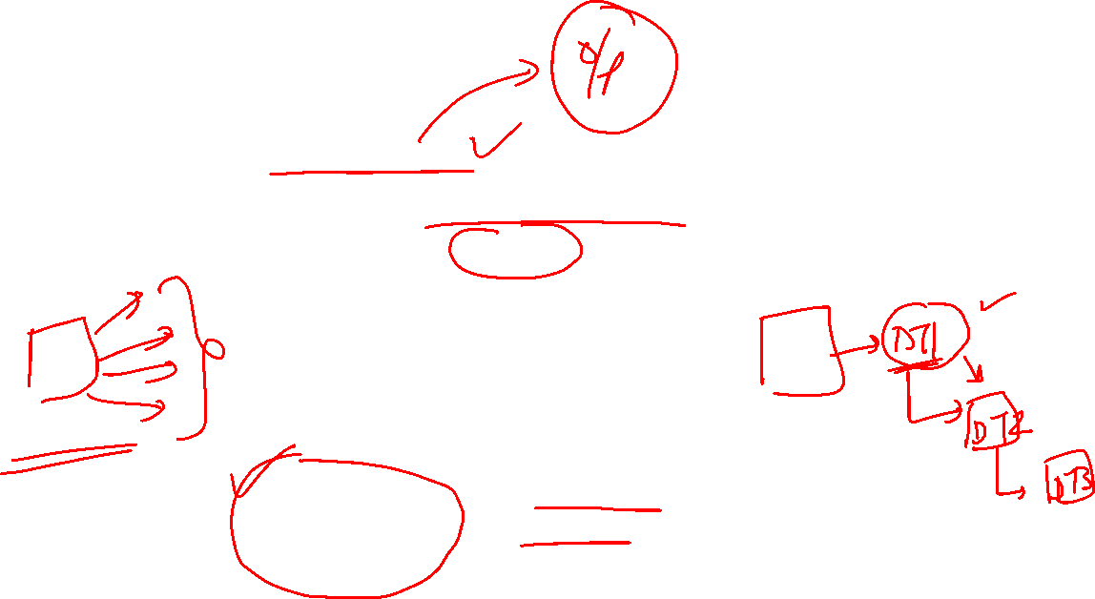
Ensemble Models
Ensemble implies combination
So a technique of combining multiple decision trees either parallelly or sequentially, results in an ensemble model.
Ensemble
Bagging/ Bootstrap (Parallel)
Boosting (sequential)

Slide 3
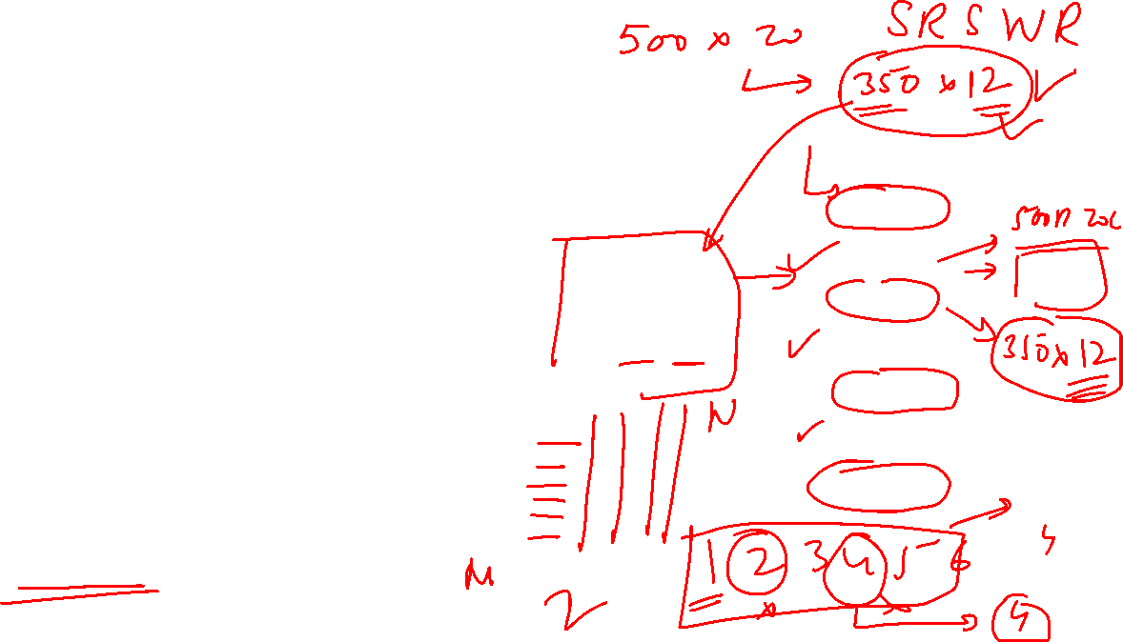
Bagging/ Bootstrap
Suppose a dataset has M rows and N columns, so there would be total M x N elements in this dataset.
For this multiple decision trees can be created from the sub-dataset of the size: m1 x n1, m2 x n2, m3 x n3 and so on…. m < M and n < N
Note: In selection of decision trees sampling is done with replacement here each
Main Data
M x N
DT1:
m1 x n1
DT2:
m2 x n2
DT3:
m3 x n3
DT4:
m4 x n4

Slide 4
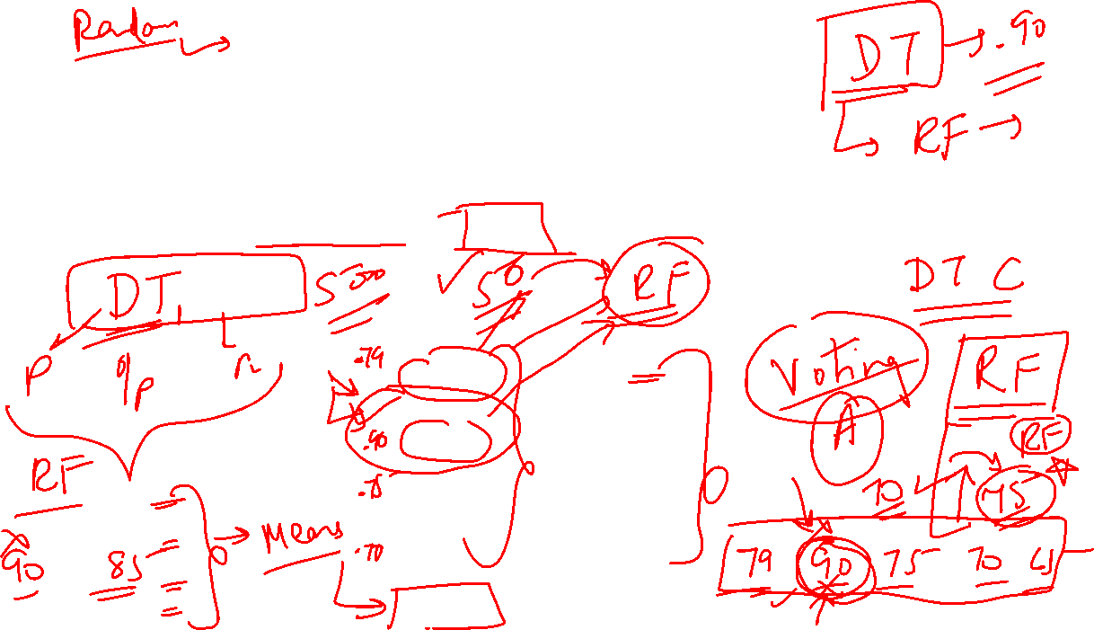
This exact process of bagging happens in random forest ML model.
Random forest as the name suggests is a combination of multiple trees.
For random forest, bagging is the ensemble technique used.
Benefits of bagging: Result of all decision trees are combined. Voting technique is used to decide the final class.
This increases the predictive power as accuracy does not depend only on 1 decision tree.
Main Data
M x N
DT1:
m1 x n1
DT2:
m2 x n2
DT3:
m3 x n3
DT4:
m4 x n4
Output: A
Output: B
Output: A
Output: A

Slide 5
Boosting
Boosting is an ensemble technique that works sequentially.
The output of first decision tree, is used to alter the approach of second decision tree. Then the output of second decision tree is used to decide the approach for third decision tree. And in this same format sequential decision trees are creating, improving the process at every point.
DT1
DT2
DT3

Slide 6
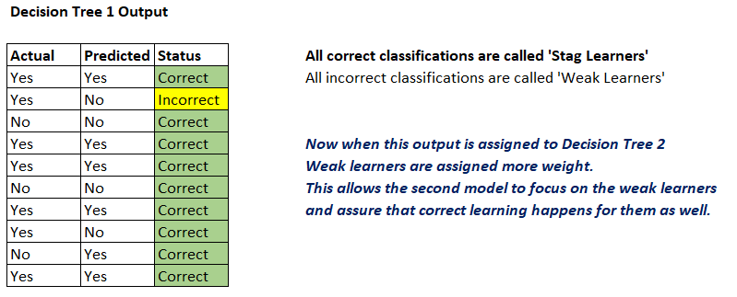
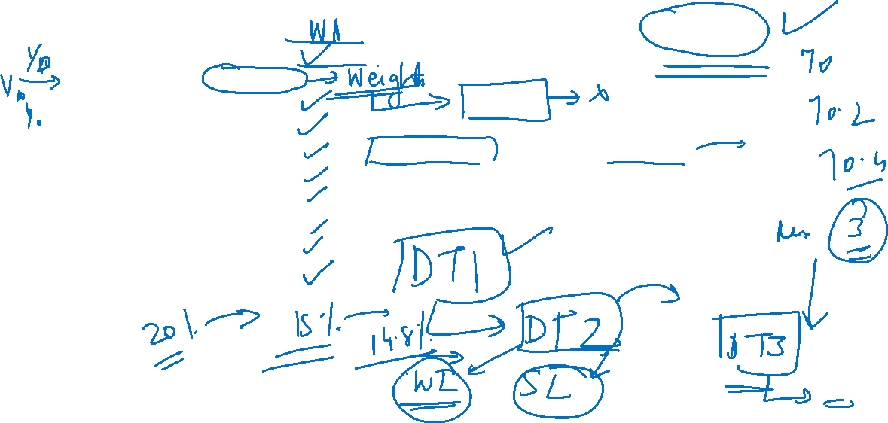

Slide 7
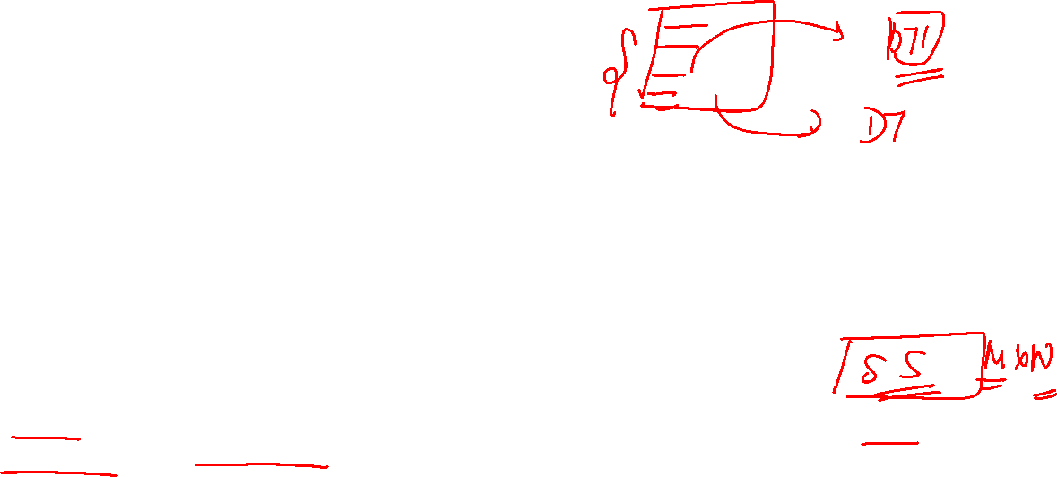
Random Forest
Random forest is a Supervised Machine Learning Model. It is made up of multiple Decision Trees.
It is based on the ‘Ensemble Techinque: Bagging’.
Since it is a combination of multiple trees the accuracy of random forest increases.
Random: emphasizes on the fact that ‘Simple Random Sampling With Replacement (SRSWR) is done.
Forest: emphasizes on the fact that multiple ‘Decision Trees’ are used to create it.

Slide 8

OOB score
OOB implies Out Of Bag.
In the ensemble technique bagging, from the complete dataset , the elements that form a group are called bag, and the elements left out are called Out Of Bag

Slide 9
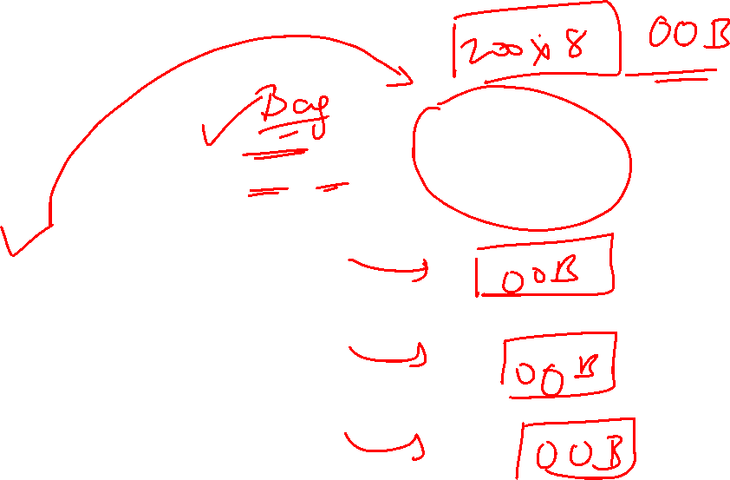
Main Data
500 x 16
DT1:
300 x 8
DT2
DT3
DT4
OOB : 200 X 8

Slide 10
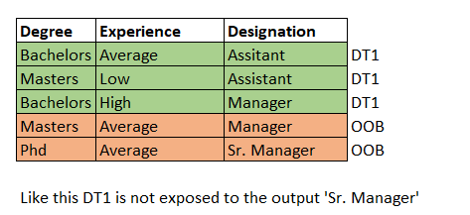
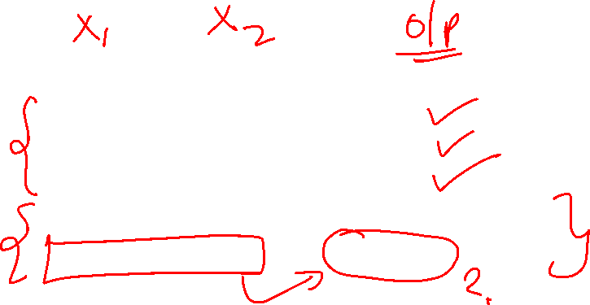

Slide 11
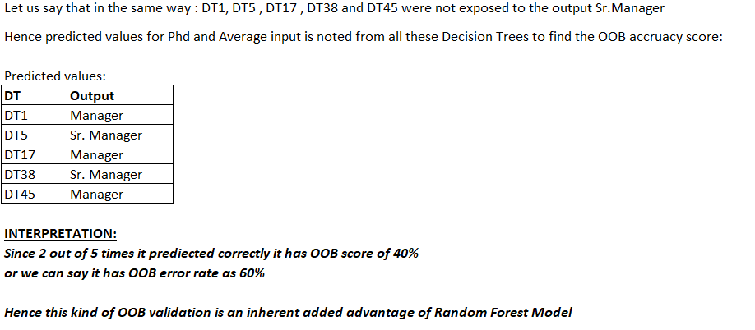
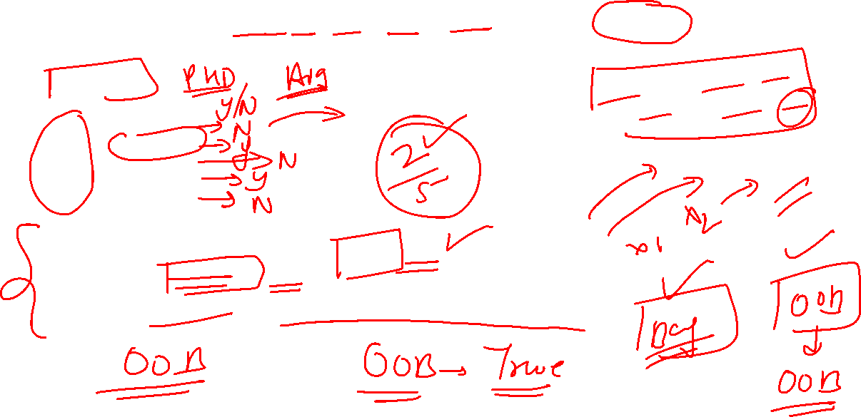

Slide 12
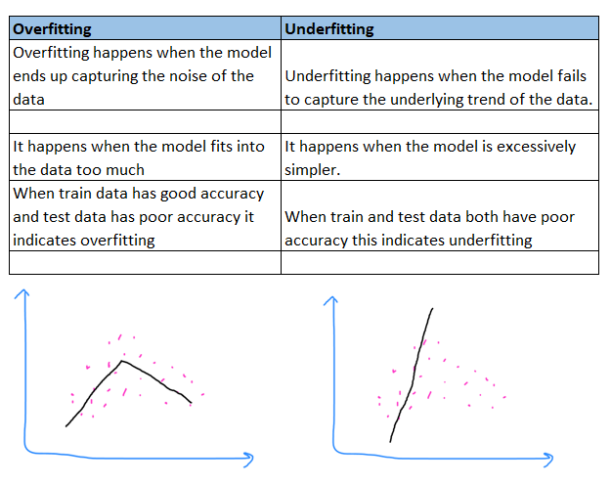
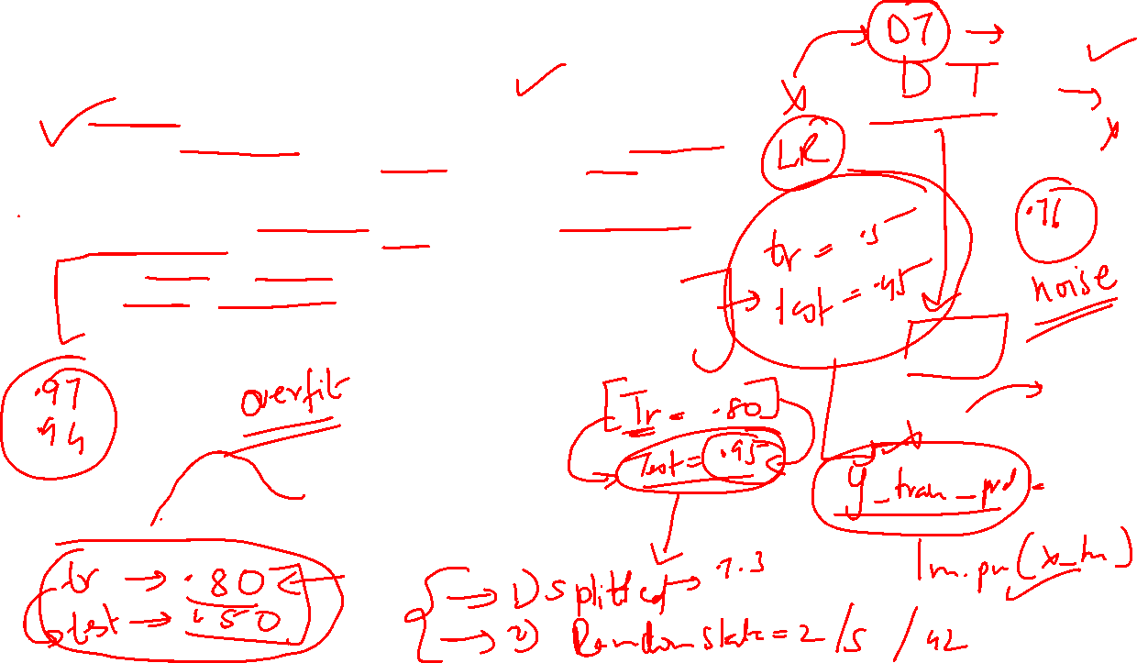

Slide 13
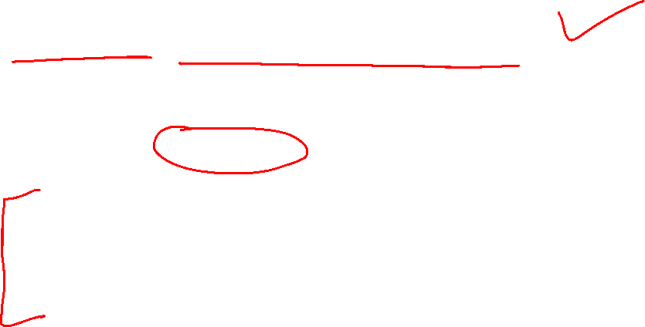
K – fold Cross Validation (CV)
This is a wonderful technique that allows to create a model that resolves the problem of overfitting.
In this entire dataset is split into k equal parts.
Everytime one part is kept as test and the remaining (k-1) parts are used for training dataset.
Second time, the next part is kept for test, and the remaining (k-1) parts contribute to the training dataset.
Like this each part serves as a test dataset and the remaining part serves as the training dataset. Like this k times the split is done and the model is worked out. This is called K fold cross validation.

Slide 14
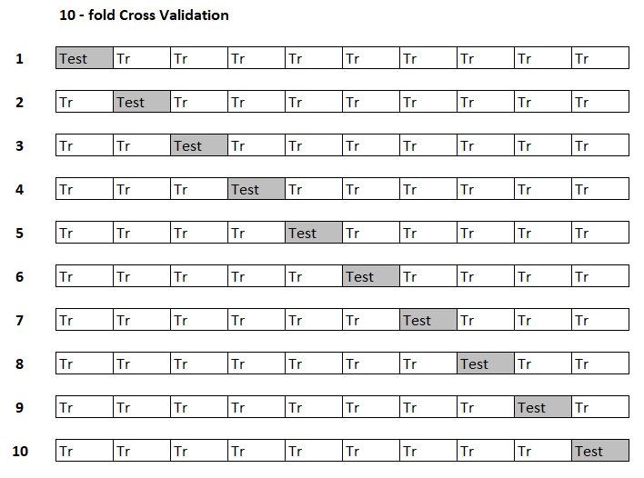
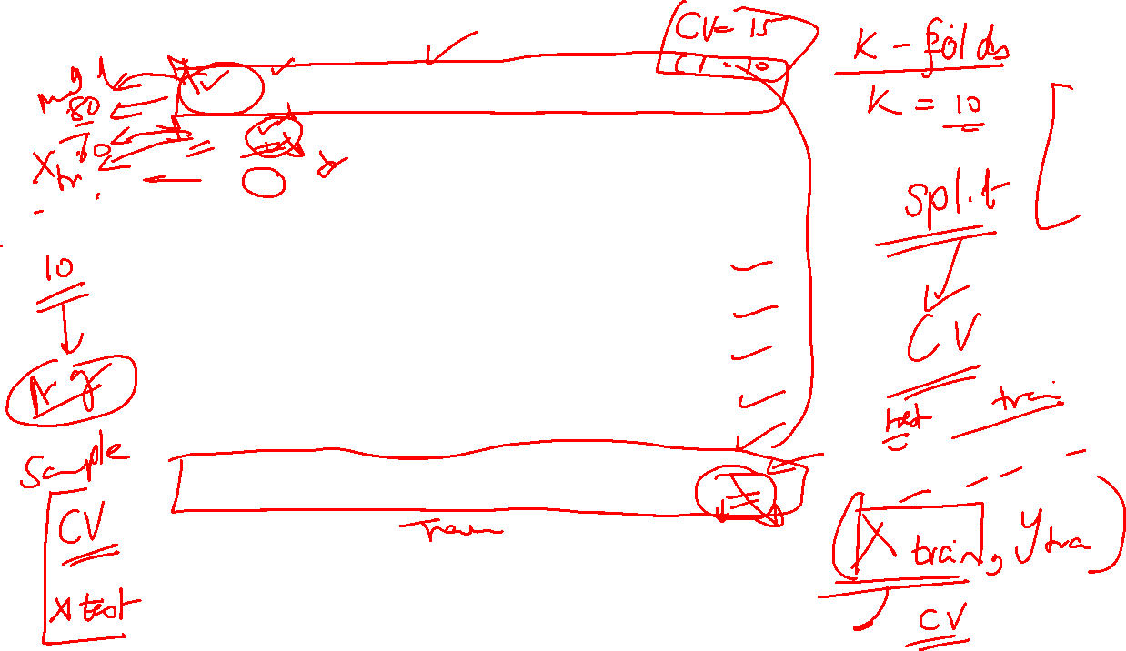
In this one split is kept as test, rest all are considered in training, this technique is called “Leave Out One (LOO)”

Slide 15
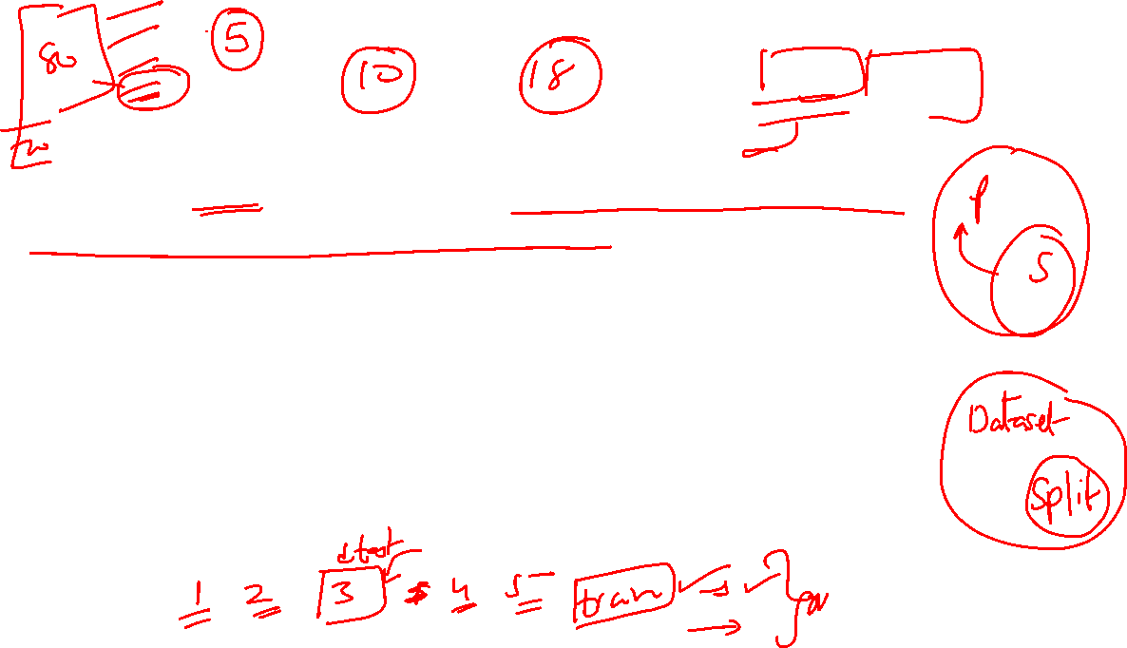
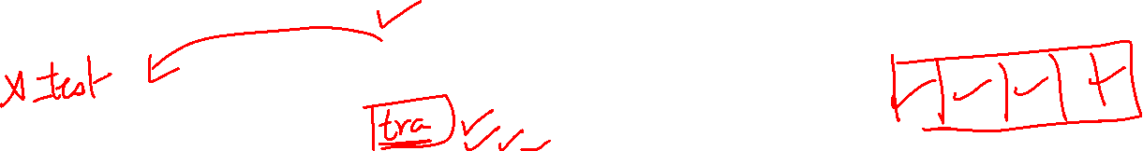
The value of K is chosen such that each split is large enough to statistically represent the complete dataset.
Generally the value of k is kept less than 20
Most commonly used values of k are 5 and 10.
Every split gets to be the test data set once, and for (k-1) times it becomes the part of the training dataset.
The evaluation values of split are noted and finally the mean evaluation of all folds is considered for the model.

Slide 16
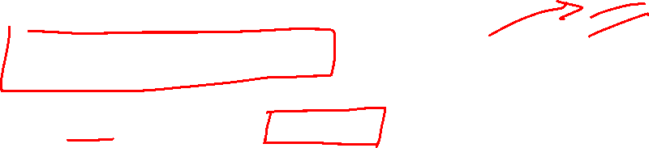
Hyperparameter Tuning:
In a model there are some parameters which are calculated by the model itself. And there are some parameters which can be controlled manually. These set of parameters are called ‘Hyperparameters’
Once the model is selected, it can be fine tuned by altering some of the hyperparameters. This allows to check for which hyperparameter value does the model generate better accuracy.
Examples of hyperparameters: ‘maximum features to include in mode’ , ‘minimum samples in the leaf node’ and so on.
These hyperparameters affect the performance of the model.
N-jobs is a hyperparameter that controls the speed of the model. It helps the model know how many jobs can be done simultaneously.
N- jobs = 1, implies one job must be done at a time.
N-jobs = 3, implies 3 jobs can be done simultaneously
N- jobs = -1, implies there is no limit on the number of tasks to be done.

Slide 17
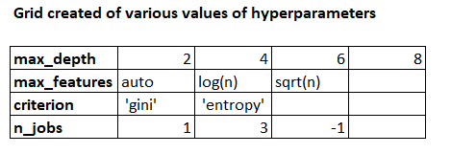
How to tune the hyperparameters?
GridSearchCV is a library in the model_selection package of sklearn that helps to select the best grid of hyperparameters.

Slide 18
